Slide 1
Optimizing Conformance to FADGI and Metamorfoze
Camera Color Calibration at National Gallery of Art
Cultural Heritage Imaging Professionals Conference
Stanford, CA
July 16 – July 18, 2014
Kenneth N. Fleisher
Color Scientist
National Gallery of Art

Slide 2
Overview
Notes:
After presenting my workflow I will show some results, and close by emphasizing the key points.

Slide 3
Assumptions
Assumptions Reference Data Calibration Process Validation Summary
Notes:
Because of the short nature of this talk, I will make some assumptions.
Camera calibration by ICC profile will never achieve deltaE = 0. Even the best calibrations will always have some color error.
As long as we are using FADGI and Metamorfoze standards to validate our calibrations, then the best calibration possible will have the best results that we can achieve from these metrics.

Slide 4
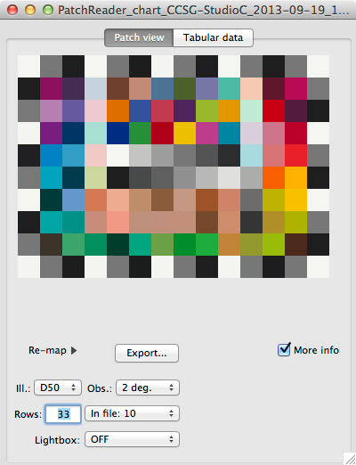
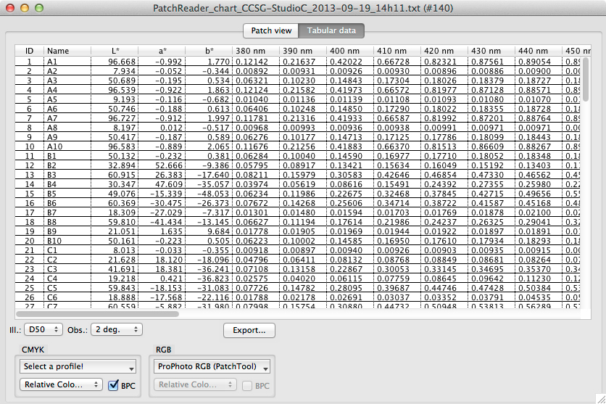
Measure
Assumptions Reference Data Calibration Process Validation Summary
Notes:
Because targets have variability, the supplied average reference data will not accurately represent OUR target. Also, the reference data supplied for camera calibration may be different from the reference data for the validation. Therefore, we must measure our targets. We take FIVE measurements of the SG chart and average these to create our reference data.

Slide 5
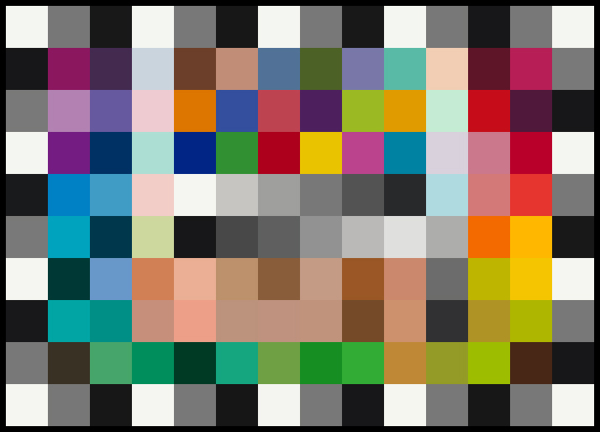
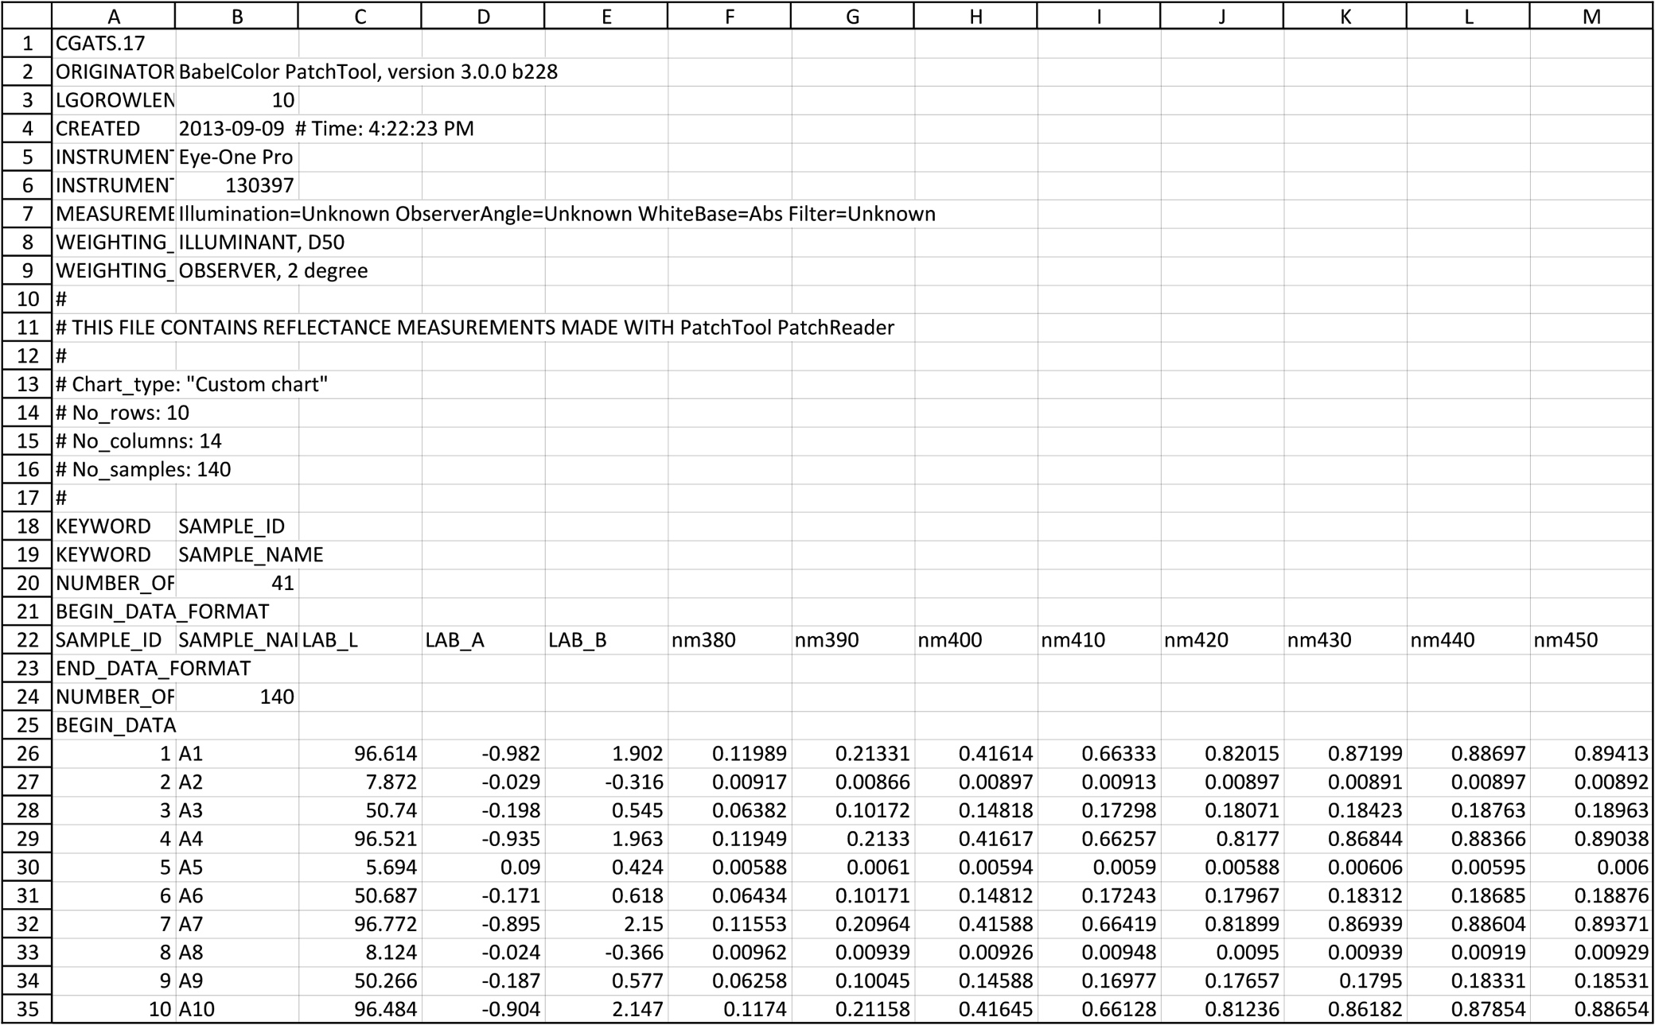
Export
Patch # | Name | R | G | B
1 | A1 | 242 | 243 | 240
2 | A2 | 18 | 18 | 19
3 | A3 | 101 | 102 | 101
4 | A4 | 242 | 244 | 240
5 | A5 | 18 | 18 | 18
6 | A6 | 101 | 101 | 100
7 | A7 | 242 | 244 | 240
8 | A8 | 18 | 18 | 18
9 | A9 | 100 | 101 | 100
10 | A10 | 242 | 244 | 240
Reference File, TIFF, Target RGB Values
Assumptions Reference Data Calibration Process Validation Summary
Notes:
Using BabelColor PatchTool, the reference data is exported as a reference file, as 4 RGB TIFF files in each of these colorspaces, and as a list of the RGB values for each colorspace.

Slide 6
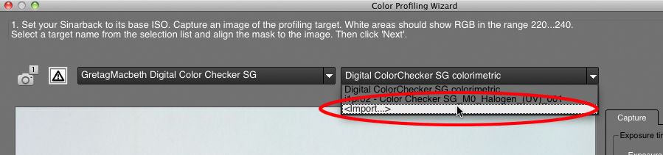
Import
Sinar CaptureFlow
Assumptions Reference Data Calibration Process Validation Summary
Notes:
Using our custom reference data allows us to generate a more accurate profile than using generic data.

Slide 7
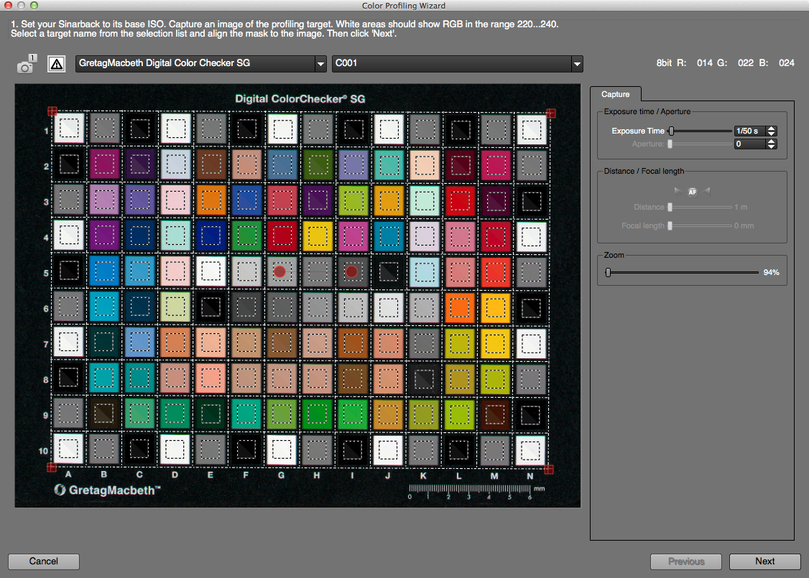
Camera Profiling
Assumptions Reference Data Calibration Process Validation Summary
Notes:
Next we follow the standard steps for calibration, making sure to utilize the custom reference data.

Slide 8
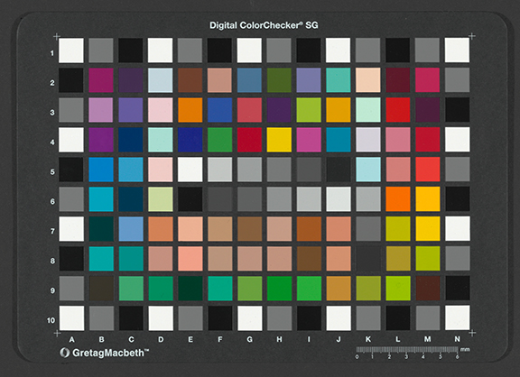
Capture Calibrated CCSG
Assumptions Reference Data Calibration Process Validation Summary
Notes:
Once the calibration is completed, we validate it by capturing the SG chart to test in IQ-Analyzer.

Slide 9
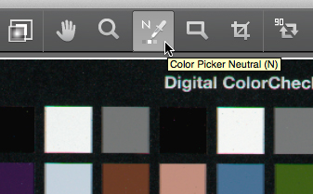
Capture Calibrated CCSG
Assumptions Reference Data Calibration Process Validation Summary
Notes:
Setting the gray balance is a key step. The gray balance tool is used to click on a neutral area in the image, in our case a neutral patch on the target. But which one should we select?

Slide 10
Capture Calibrated CCSG
Assumptions Reference Data Calibration Process Validation Summary
Notes:
Some people elect to use the whitest color patch.

Slide 11
Capture Calibrated CCSG
Assumptions Reference Data Calibration Process Validation Summary
Notes:
Others will neutralize on the second whitest patch.

Slide 12
Capture Calibrated CCSG
Assumptions Reference Data Calibration Process Validation Summary
Notes:
Some will select the middle gray patch. There are no guidelines for this and one could probably make a valid argument for any of these. So which one do we use? The answer is…

Slide 13
Capture Calibrated CCSG
Assumptions Reference Data Calibration Process Validation Summary
Notes:
None of them! If you think about it, neutralizing any of these patches is not the correct thing to do.

Slide 14
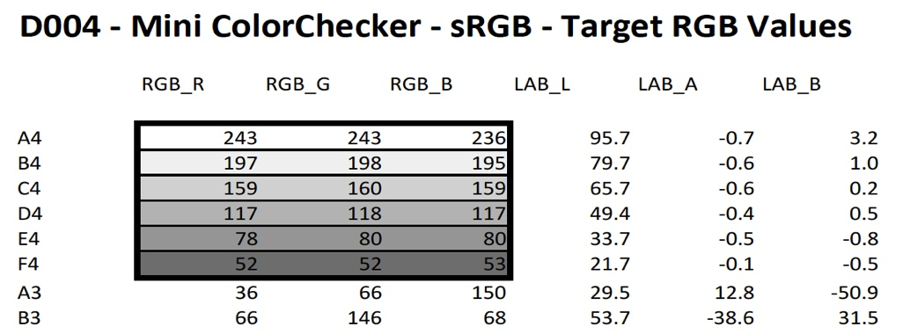
Capture Calibrated CCSG
Assumptions Reference Data Calibration Process Validation Summary
Notes:
If you look at the LAB values for the six gray patches on a Mini ColorChecker, you can see that none of them are actually neutral, so why would you want to make their RGB values equal? What happens to the other patches after you gray balance on one of them?

Slide 15
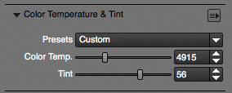
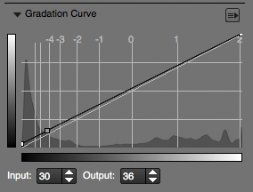
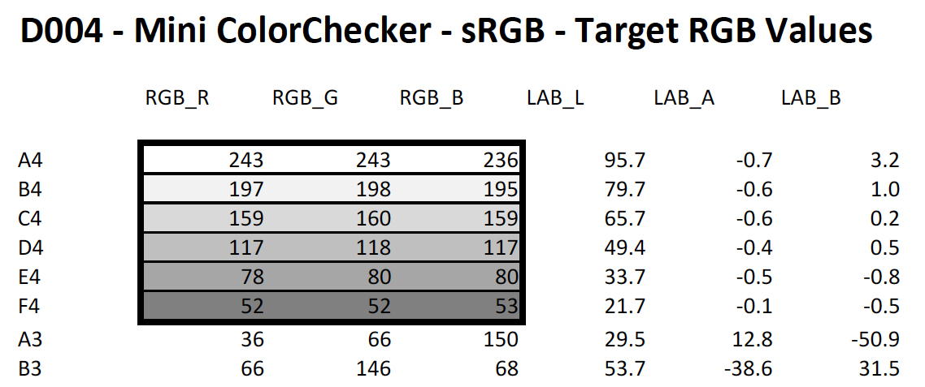
Capture Calibrated CCSG
Assumptions Reference Data Calibration Process Validation Summary
Notes:
Instead of doing the standard gray balance step, we adjust the Color Temperature, Tint, and Curve settings along with exposure until our test captures match the target RGB values. We have found that when the settings make the white patch as close as possible its target RGB values, the rest of the colors on the target fall in line very well. Sometimes we will need to make slight adjustments to the gradation curve as well to bring the rest of the gray patches and the tone scale in line. This step often vastly improves the ability of the profile to match the chromatic colors very closely.

Slide 16
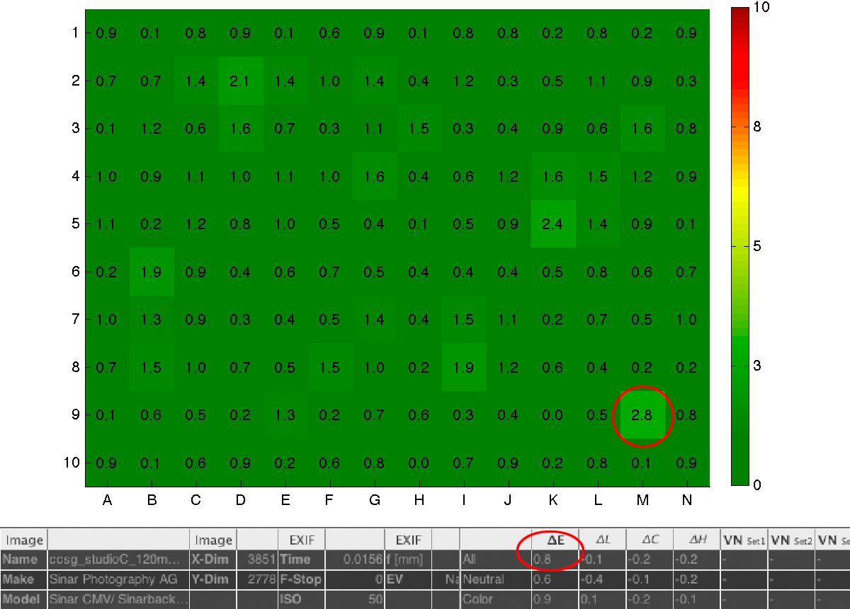
Results
Assumptions Reference Data Calibration Process Validation Summary
Notes:
As you see here, the results of the camera calibration are excellent. We achieved an average DeltaE of 0.8 with a maximum DeltaE of 2.8. It’s my opinion that this is about as good of a calibration that can be achieved using an ICC workflow.

Slide 17
Results
Assumptions Reference Data Calibration Process Validation Summary
Notes:
You can see from these results that we are achieving color errors much smaller than the allowed tolerances for each of the standards. Keep in mind that I am comparing the achieved color against the expected ACHIEVABLE color. If you don’t do this, you don't know if the error you have is due to a mismatch between the target & reference data, from out of gamut colors in a particular colorspace, or if you have not actually optimized your calibration. So I believe it is better to use reference data measured from your target, and gamut limited for your working color space, so you can get a better sense of the success of your calibration.

Slide 18
Summary
Assumptions Reference Data Calibration Process Validation Summary
Notes:
In summary, the key points are to measure your own targets, use those measurements to generate reference data for profiling and validation, profile the camera, and instead of using the standard gray balance step, adjust the color temperature, tint and gradation curve, along with the exposure, until your capture matches the expected RGB values.

Slide 19
Thank You
Questions?
k-fleisher@nga.gov
(202) 712-7471
Kenneth N. Fleisher
Color Scientist
National Gallery of Art

